Slide 1
Secure Data Hiding in Images Using Steganography
CAPSTONE PROJECT
Presented By: Manass Y Panicker
Student Name : Manass Y Panicker
College Name & Department : T.John College

Slide 2
OUTLINE
Problem Statement
Technology used
Wow factor
End users
Result
Conclusion
Git-hub Link
Future scope

Slide 3
Problem Statement
Traditional encryption methods secure data but can be easily detected. This project uses steganography to hide secret messages inside images, making data transmission discreet. Unlike conventional tools, it also includes password protection and encryption for added security. The goal is to create an easy-to-use yet highly secure steganography tool with a modern interface.

Slide 4
Technology used
Python (Core Language)
Custom Tkinter (GUI Framework)
Open CV (Image Processing)
Pillow (PIL) (Image Handling)
AES Encryption (For added security)
PyInstaller (To convert to .exe)
Windows 11
Visual Studio (latest version)
Tested on AMD Ryzen 7 4800H 32GB RAM

Slide 5
Wow factors
Modern GUI with Dark Mode toggle
Password Protection for decryption
Steganography + Encryption (Double Security)
User-Friendly Interface
Standalone .exe Installer (No Python required)

Slide 6
End users
Journalists & Activists (For secure communication)
Cybersecurity Professionals (For testing steganography techniques)
Students & Researchers (For learning and experimentation)
General Users (For hiding sensitive data in images)

Slide 7
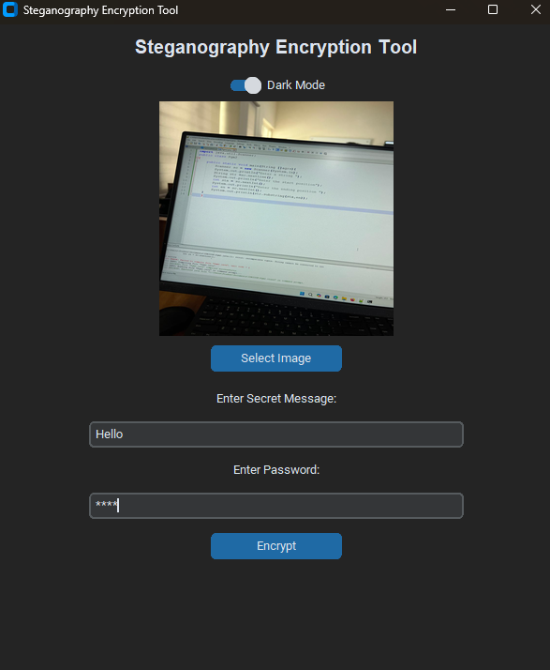
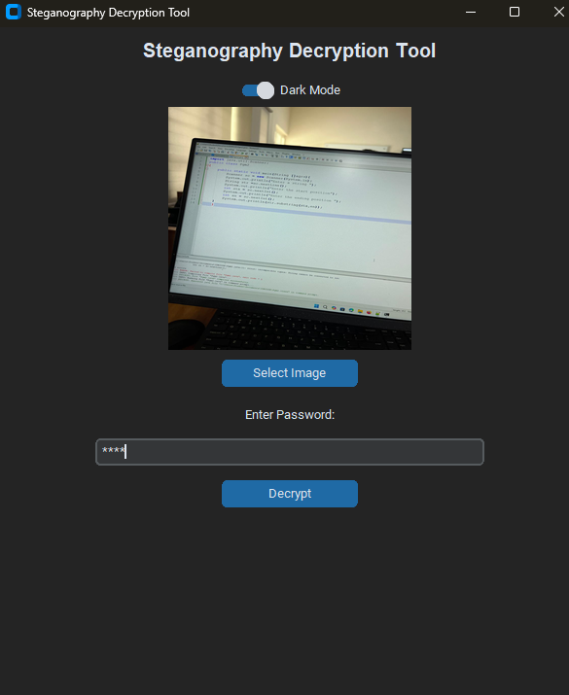
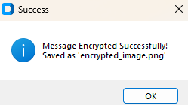
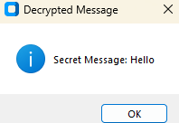
Results

Slide 8
Conclusion
This project enhances data security & privacy by merging steganography & encryption into a powerful yet simple tool. The addition of modern UI features makes it user-friendly while ensuring strong protection for confidential messages.

Slide 9
GitHub Link
https://github.com/ManassYPanicker/Steganography

Slide 10
Future scope(optional)
🔹Support for More File Types (Audio, Video Steganography)
🔹 QR Code Steganography (Hiding data inside QR codes)
🔹 Improved Encryption (Using AES-256 for stronger security)
🔹 Mobile App Version (For Android & iOS)

Slide 11
THANK YOU!

